Slide 1
Lecture 13

Slide 2
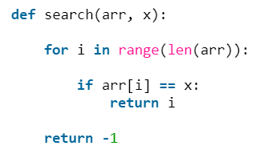
Basic For Loop Search
Search a list given a value and return its location.

Slide 3



Random Library

Slide 4
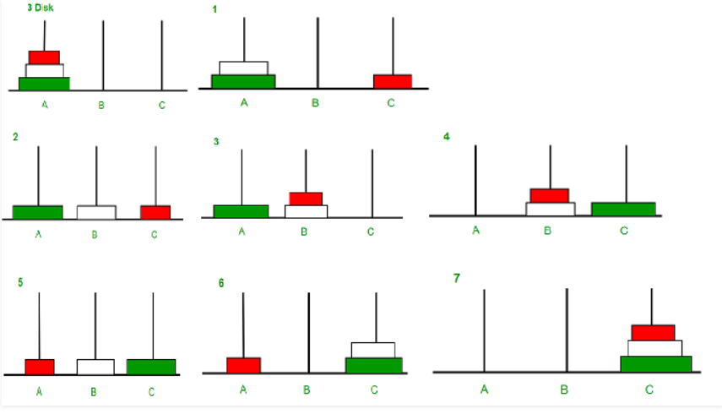
Tower of Hanoi

Slide 5

Tower of Hanoi

Slide 6

Printing a File Directory

Slide 7
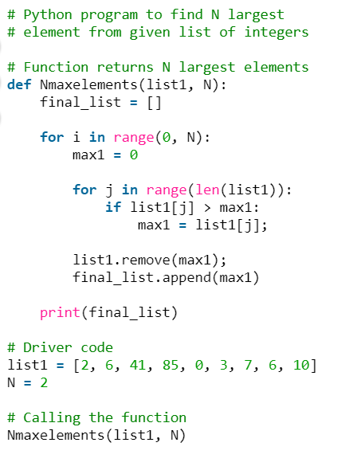
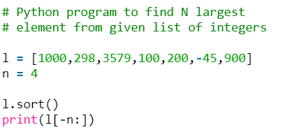
List Smart Search

Slide 8
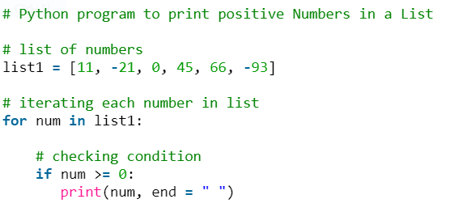
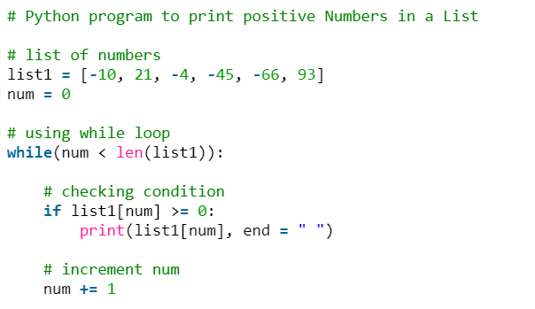
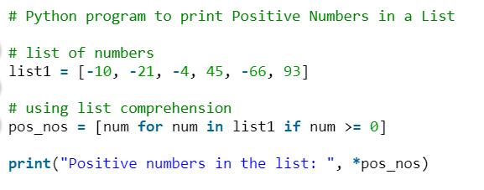
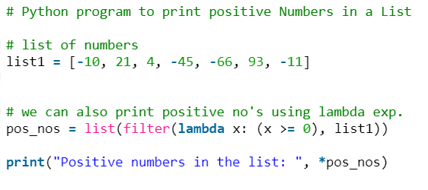
Printing Positive or Negative Numbers

